Slide 1





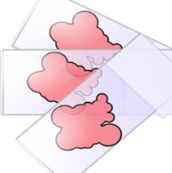
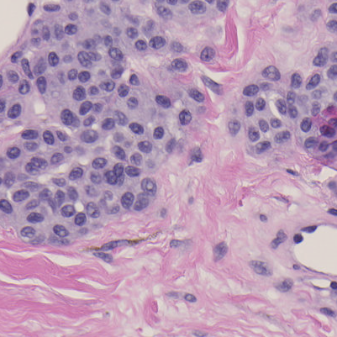

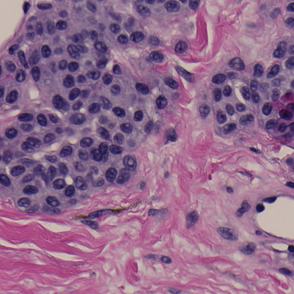
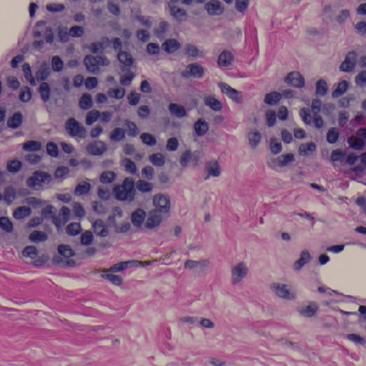
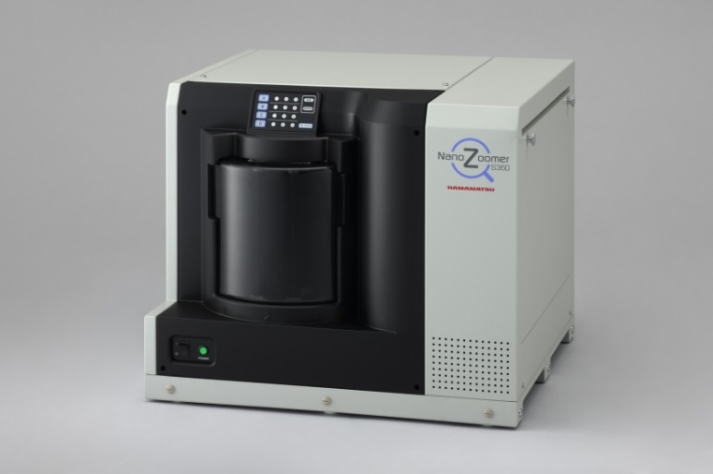
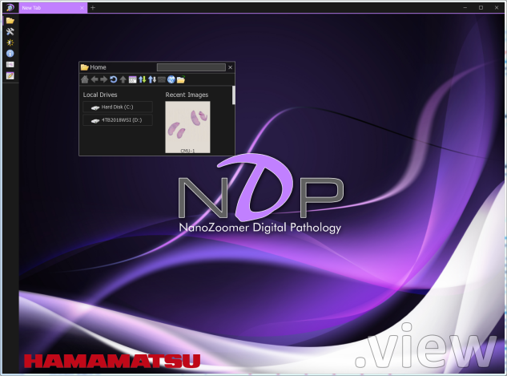
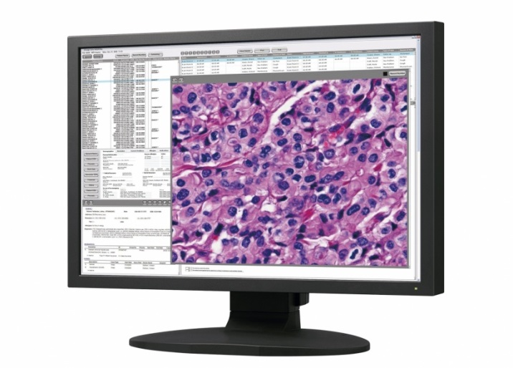
Third-party whole-slide image viewers do not produce the same image
Samuel Lam¹, Qi Gong², Wei-Chung Cheng²
¹Department of Computer Science, University of Maryland, College Park; ²FDA/CDRH/OSEL/DIDSR
Experiments demonstrate why bench tests are required for third-party WSI viewers
Clinical Area: Medical Imaging
ABSTRACT
TEST SUBJECTS
Boxplot of ∆E between 6 pairs
N: NDP
S: Sedeen
A: ASAP
Q: QuPath
Three freely available third-party whole-slide image viewers were compared with the factory viewer on the pixel level. Experiment results show that some viewers generated excessive errors.
Input WSI file: “CMU-1.ndpi” generated by a Hamamatsu scanner
Four WSI viewers and their output images:
NDP.view2
Hamamatsu
Sedeen
PathCore
QuPath
Queen’s U
ASAP
Radboud U
BACKGROUND
A whole-slide imaging (WSI) system used in digital pathology consists of the scanner, viewer, and display components. So far, only two WSI devices have been cleared by the FDA. Recently, independent WSI viewers were submitted by third-party vendors to replace the original viewer component as alternatives. However, these viewers were not adequately tested because the vendors believe that the image is just digital data and will not be altered by their software.
RESULTS
FINDINGS
Four images: 6 pairs to compare
Heat maps show ∆E for each pixel
Mean and standard deviation shown in title
Histogram shown in inset
Boxplot shown in right column
NDP and Sedeen:
Very close but not identical (µ=1.30, σ=1.35)
∆E pattern does not correlate with tissue structure
A few pixels have high ∆E (outliers)
ASAP and QuPath:
Different from reference (µ=18.79 and µ=18.69)
∆E w.r.t. reference correlates with tissue structure -- nuclei have higher ∆E (yellow); stroma lower (green)
Different from each other (µ=2.19, σ=2.33) in macroblock patterns
ASAP vs NDP/Sedeen/QuPath
“Pixelized” ∆E patterns similar to lossy compression
WSI file
Scanner
Viewer
Display
ASAP
Components of a WSI system
RESEARCH QUESTION
Do different WSI viewers generate identical images for the same WSI file?
METHODOLOGY
CONCLUSIONS
Use AutoHotKey to open the same WSI file with two different viewers
Use AutoHotKey to generate keyboard/mouse events to select a predefined region-of-interest (ROI) in the reference viewer
Use AutoHotKey to select the same ROI automatically in the third-party viewer
Use Windows Snipping Tool to capture and save the screenshots [1]
Use MATLAB to check the registration accuracy; if not registered correctly, go back to Step 3
Use MATLAB to calculate the color difference (∆E) for each pixel
Use MATLAB to report statistical and graphic results
For the same input file, four different WSI viewers generated four different images. It confirms that any WSI viewer can reproduce digital images identically is a fallacy. The concept of interoperability between WSI components needs to be revisited to include image integrity on the pixel level. Before a WSI file format is standardized, third-party viewer vendors should work with the scanner manufacturer instead of relying on untested free libraries. More adequate bench testing data are needed for 510(k) WSI viewer submissions.
NDP
FUTURE WORK
Determine sources of ∆E (color profile? JPEG?)
Repeat experiments for cleared devices (Philips, Leica)
Develop bench test methods (software, hardware)
Determine acceptable criteria
AutoHotKey
Script
registration error
REFERENCE
zoom/pan
∆E,
heat map,
histogram, boxplot
QuPath
Sedeen
Calvin Sun and Wei-Chung Cheng, How Much Can Bad Display Calibration Cost? 2017 FDA Summer Student Poster Day.
3rd-party Viewer
view
Screenshot
image
Registration
image
Color Difference
WSI
ACKNOWLEDGEMENTS
Reference Viewer
view*
image*
image*
This study was supported by ORISE. The mention of commercial products herein is not to be construed as either an actual or implied endorsement of such products by the Department of Health and Human Services. We are grateful to Jonathan Boswell for helping in setting up this study.

